Slide 1
Why R? (and what even is R?)
Dr. Ana Miller-ter Kuile
Postdoctoral Researcher, School of Informatics, Computing, and Cyber Systems
ana.miller-ter-kuile@nau.edu
Notes:
Students need to bring computers to all sessions
Share website with students prior – ask Anita to have them do the pre-workshop task of downloading R and Rstudio and the pre-workshop survey

Slide 2
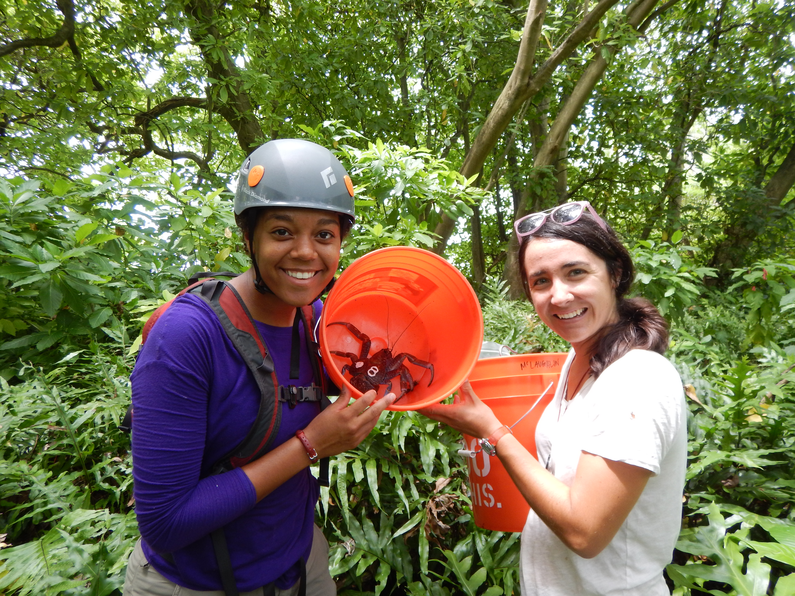
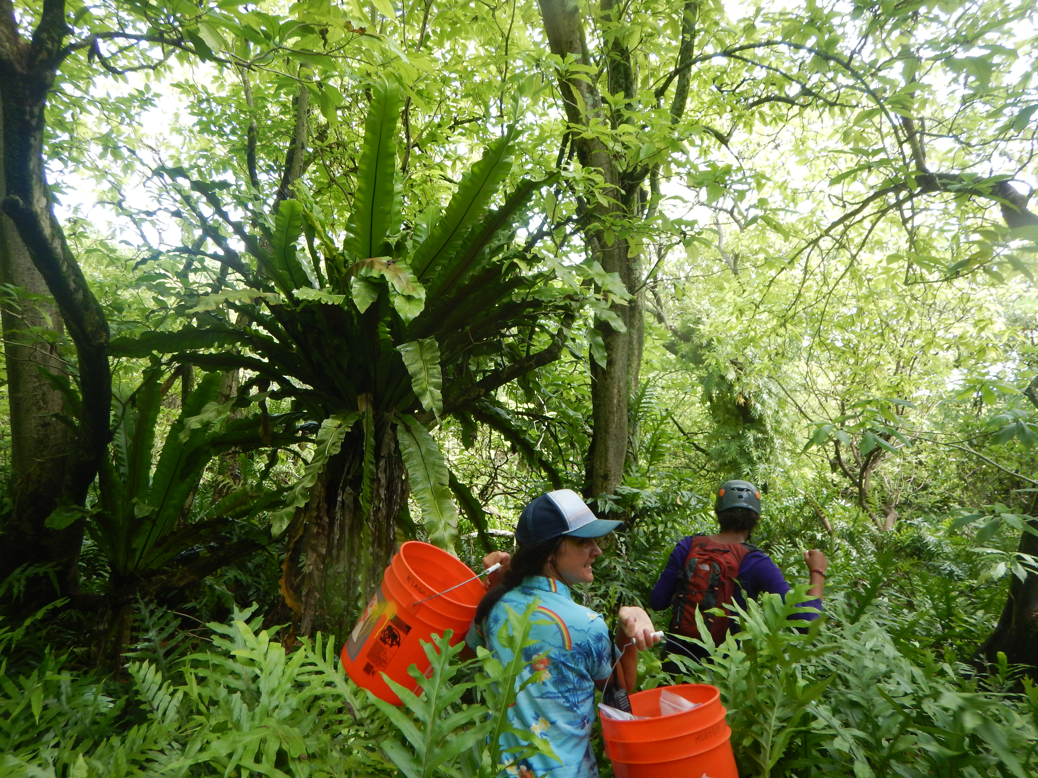

Slide 3
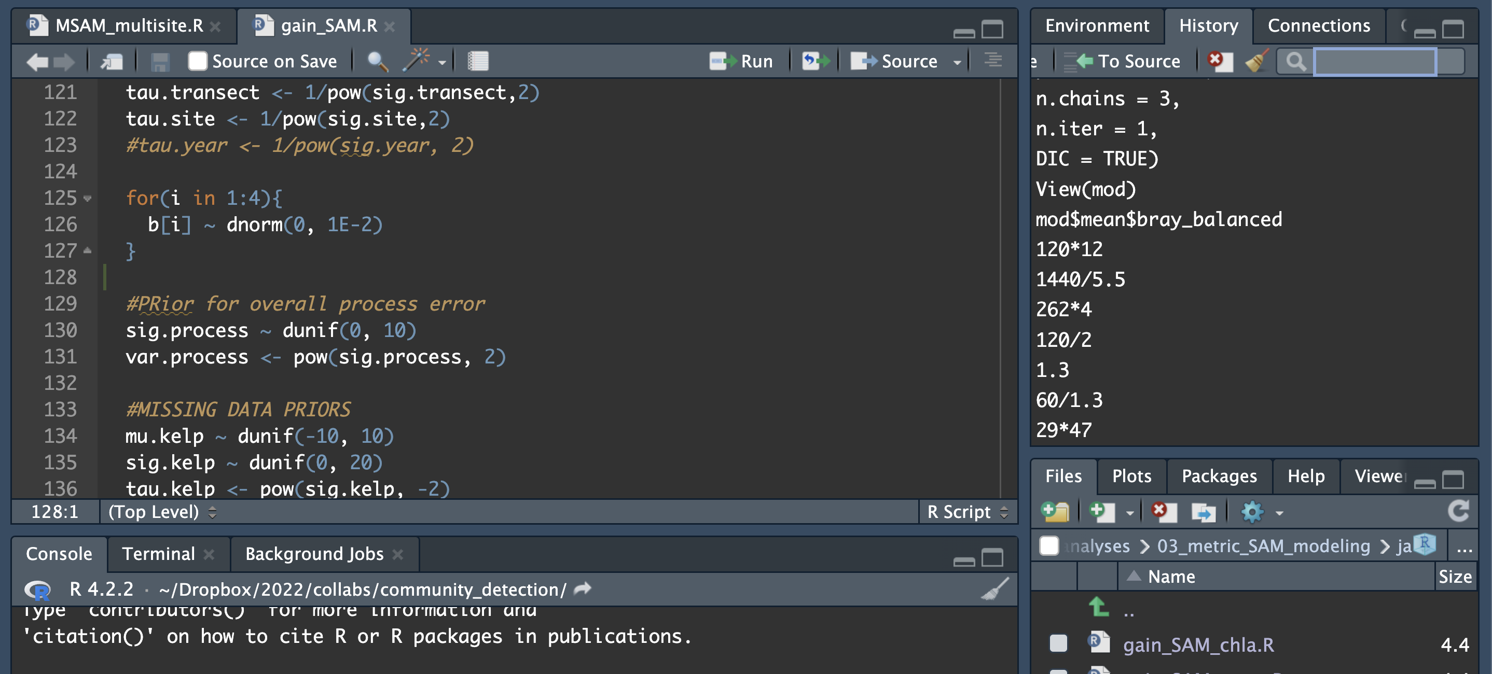

Slide 4

Goals of this workshop series
To introduce you to coding in R and why it’s useful
To gain confidence in the ways that ecologists may use R to explore, analyze, and visualize data
To try out some skills on your own datasets

Slide 5

What is R?
R is a programming language and software used to run code written in R

Slide 6

Why use R?
R is multi-functional
R is cross-disciplinary
R is a “transferrable skill”

Slide 7
Why R for Ecologists?

Slide 8
R is multi-functional
organize data ('clean")
Analyze data
Visualize data

Slide 9
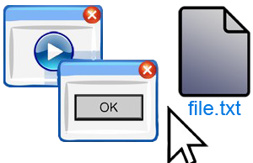
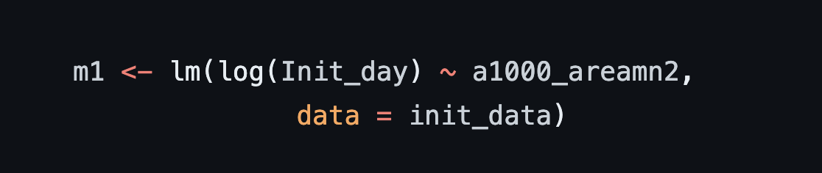
R is “reproducible”
vs
No pointing and clicking
Easy to incorporate new data as you collect it
Easy for others to look at your work and suggest improvements
Easy for someone (including future you) to re-do similar processes or repeat the same processes later

Slide 10
R works for many kinds of data
Not limited to a single data type
Excel-type data, GIS spatial data, genetics data, etc!
Can even work with really big data files

Slide 11
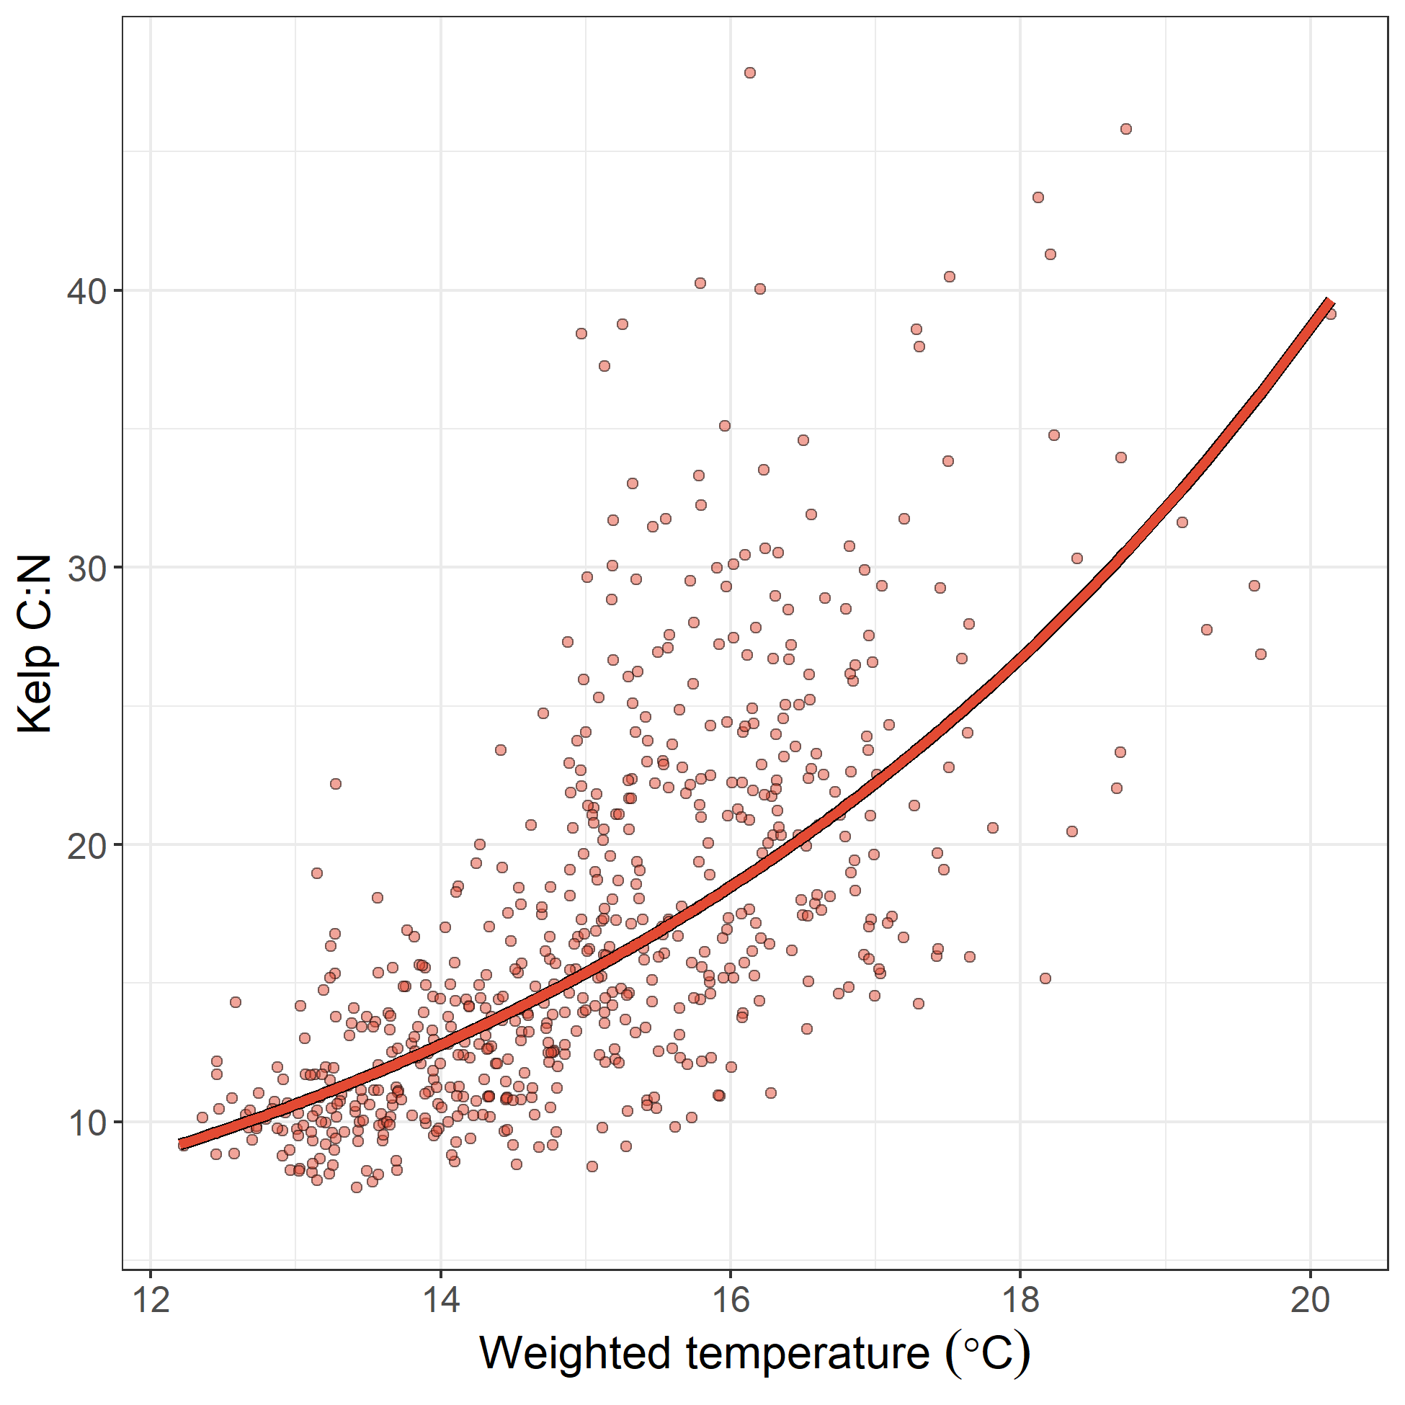
You can make pretty pictures in R

Slide 12
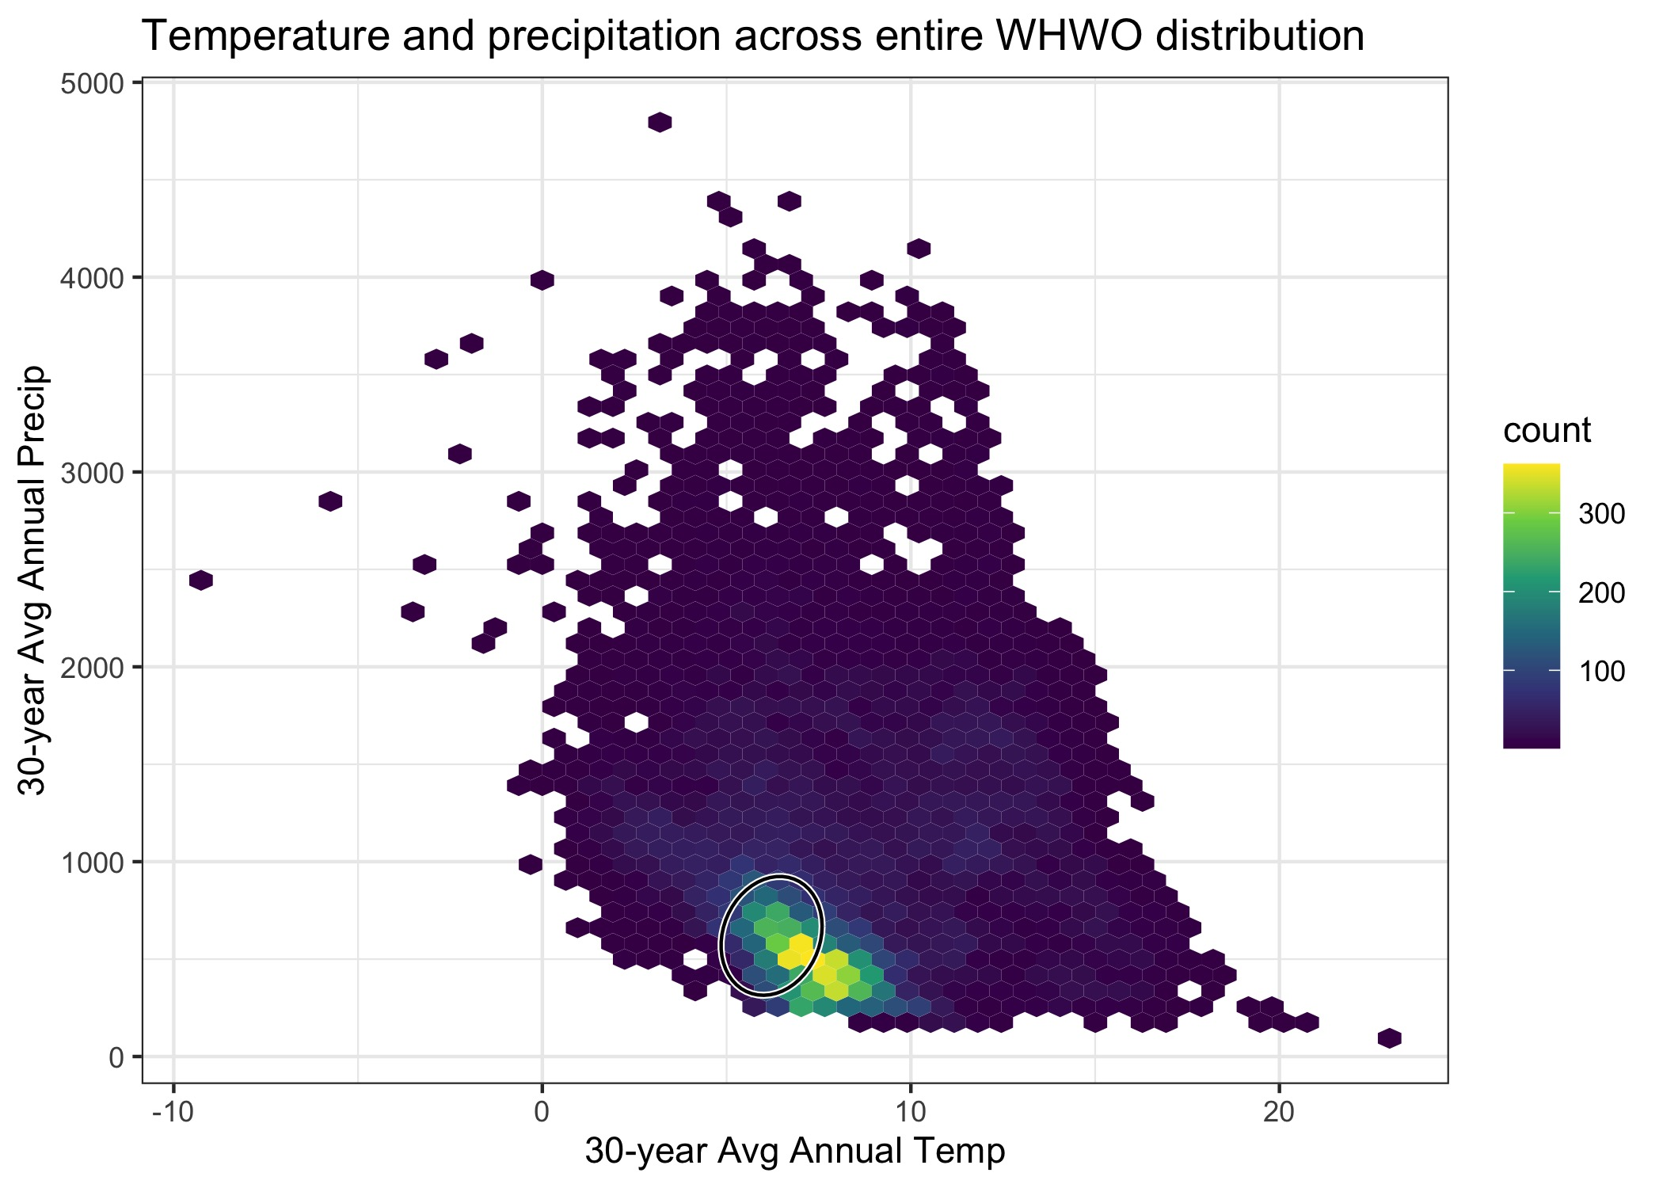
You can make pretty pictures in R

Slide 13
You can make pretty pictures in R

Slide 14
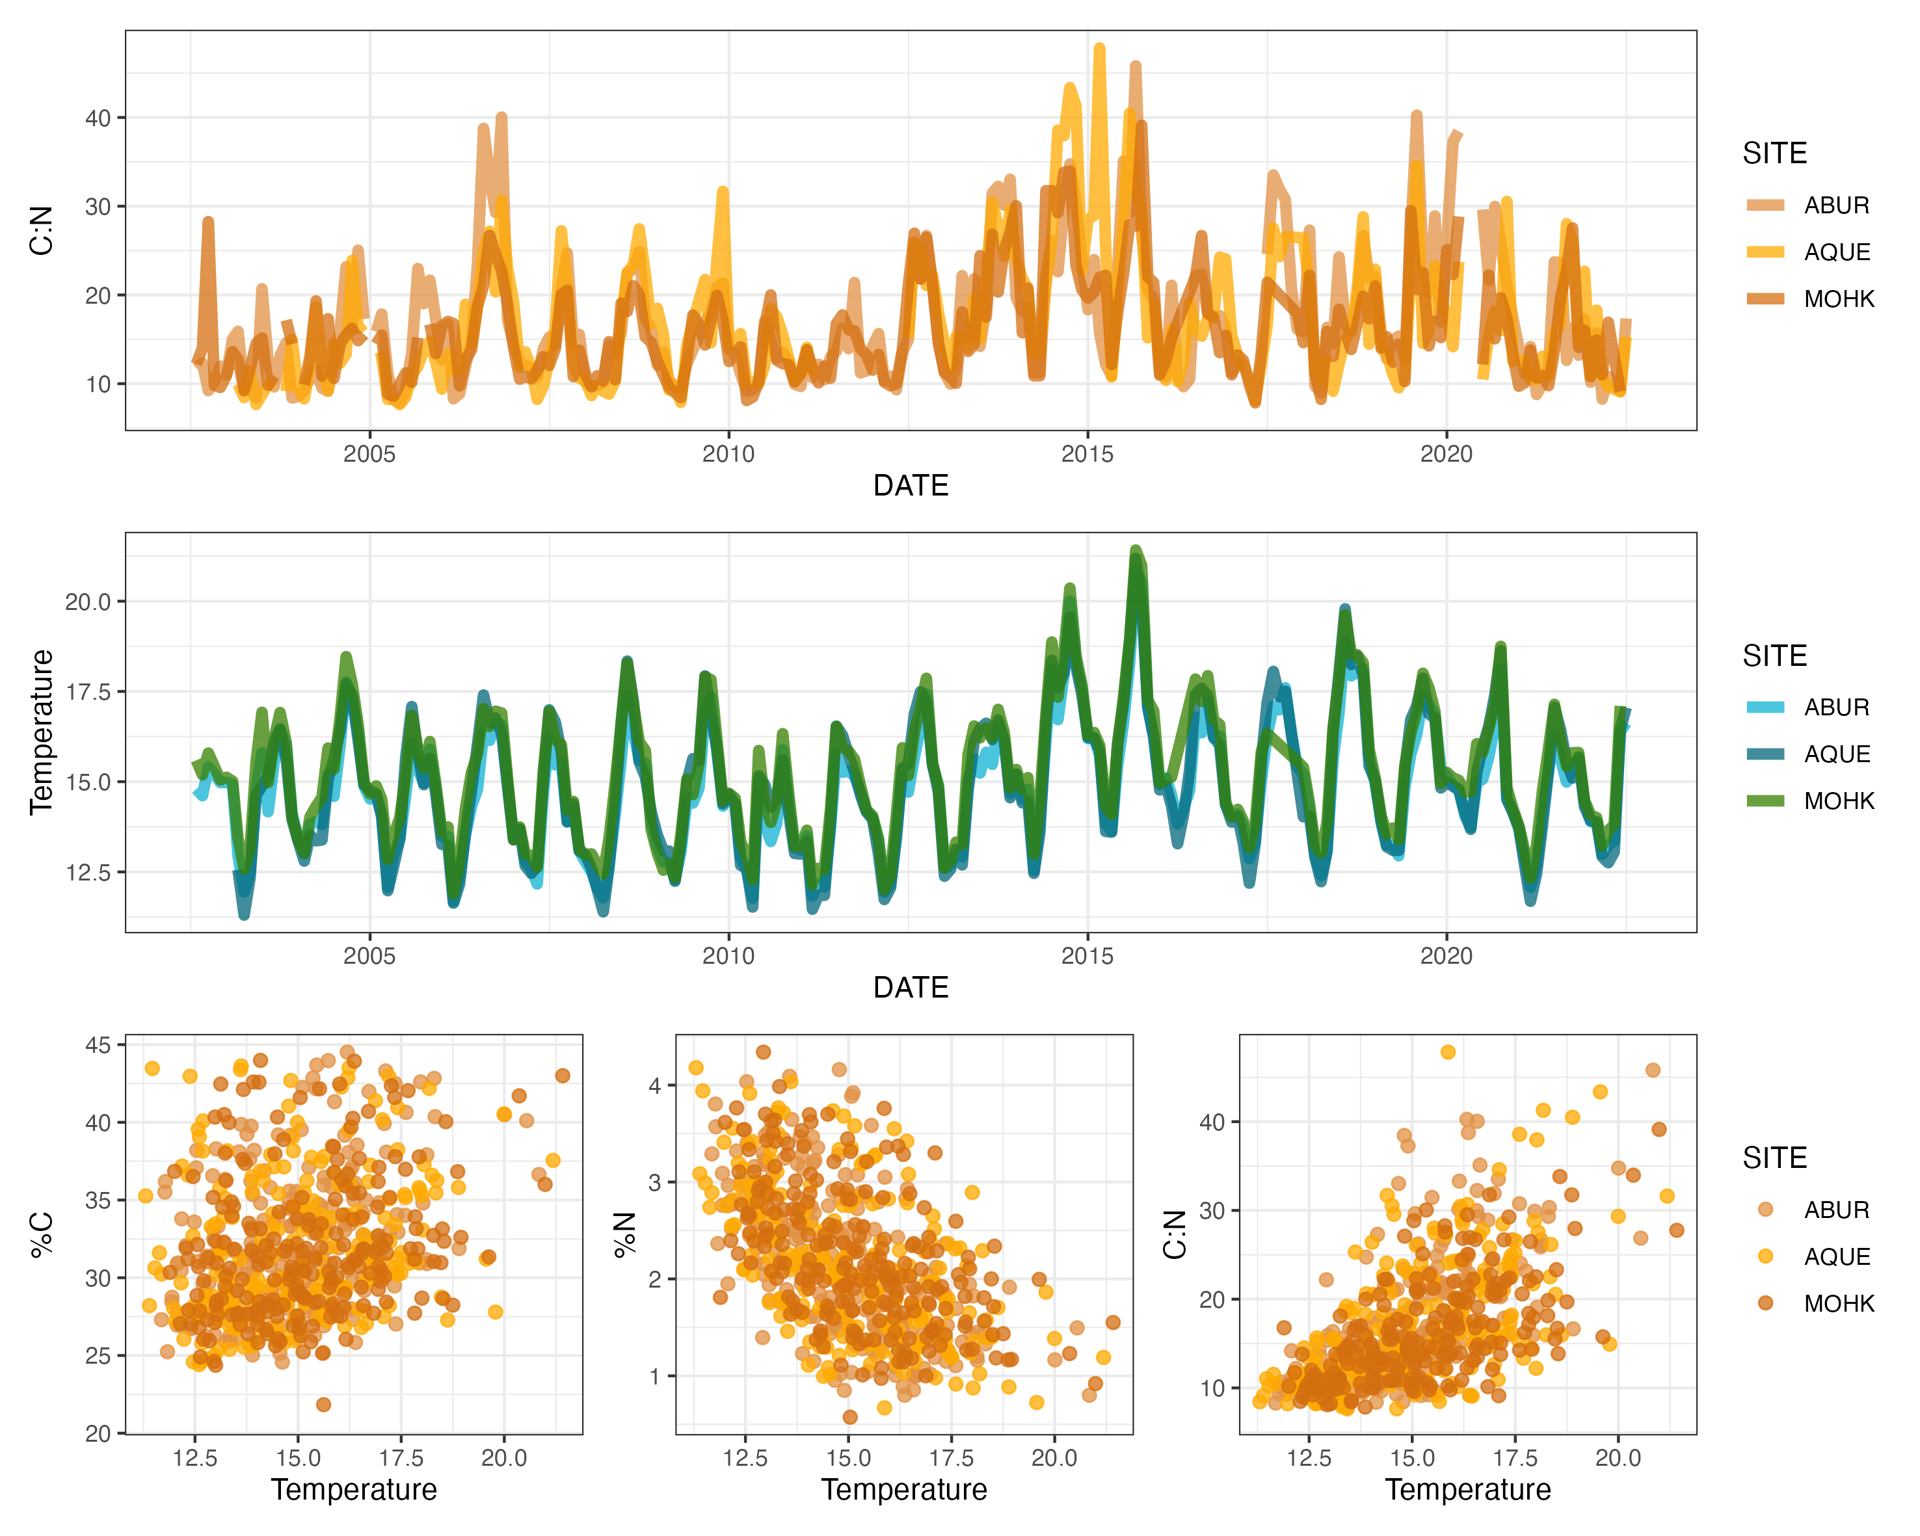
You can make pretty pictures in R
Heili Lowman

Slide 15
R Beyond Ecology

Slide 16
R is interdisciplinary
Used across many fields
Data analysts at Google use the same functionality of R that I use (’transferrable skill’)
Anything from image analysis, text analysis, GIS, time series, genetics, statistics and more can be done in R

Slide 17
R has a great community of support
Rstudio Community and Stack Overflow can answer all the questions to all your errors
You can Google an error and find solutions
Answers are geared toward researchers, since many researchers use R (not geared toward software engineers)

Slide 18
R is free and you can contribute to it!
You can add your own ways of working with data to R
Anything created by others in R is free for you to use
You can use R on Mac, Windows, and Linux

Slide 19
R is multi-purpose
I mentioned data organization (‘cleaning’), analysis, and visualization, but there’s even more!
You can use R extensions to create beautiful websites, books, tutorials, and even interactive data-driven websites
R easily interfaces with programs like Quarto, Rmarkdown, and Rshiny to do these things

Slide 20
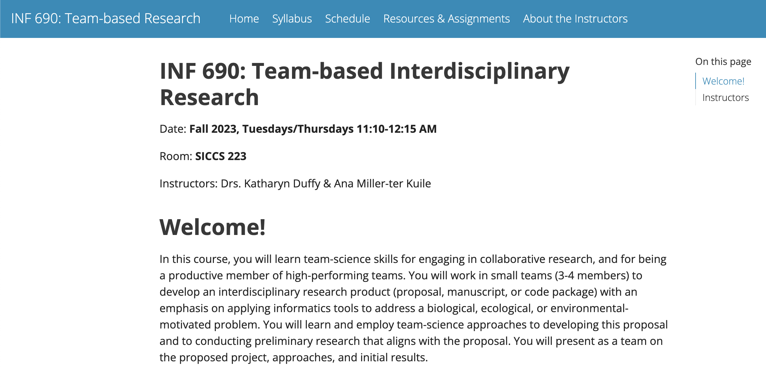
Websites

Slide 21
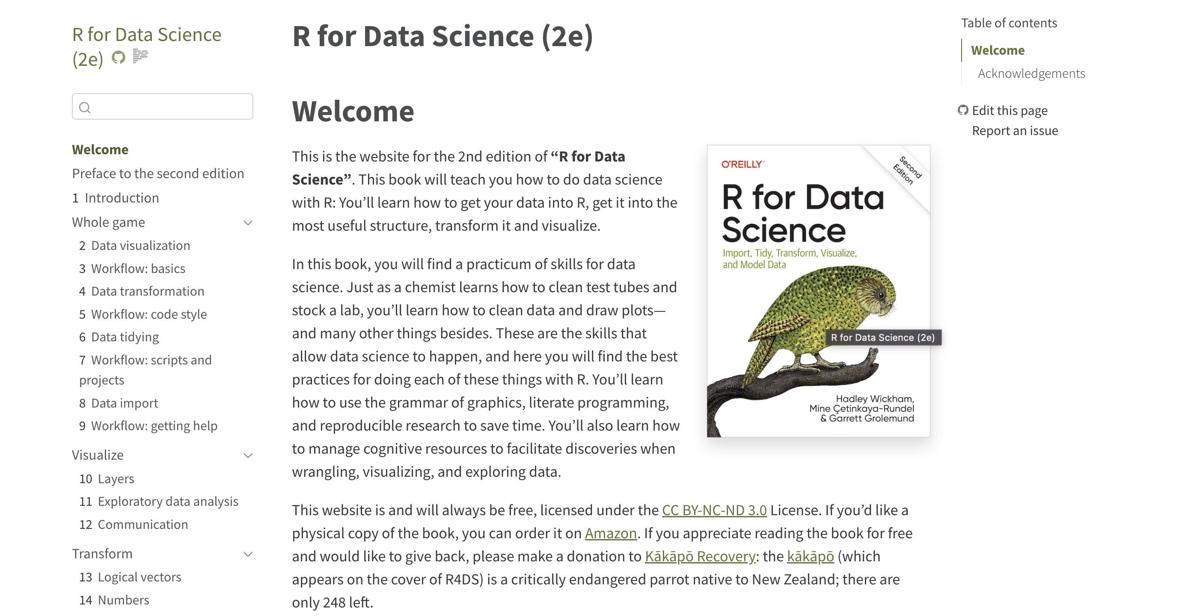
Books

Slide 22
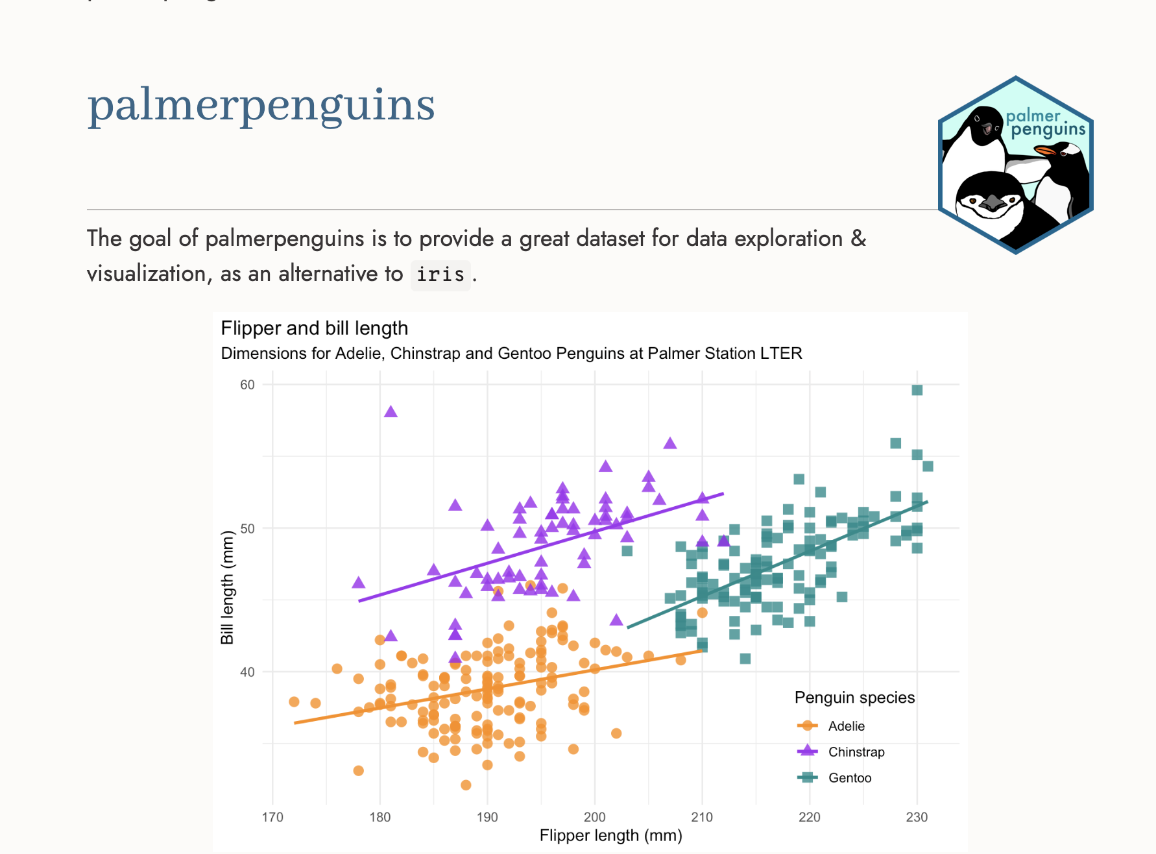
Tutorials

Slide 23
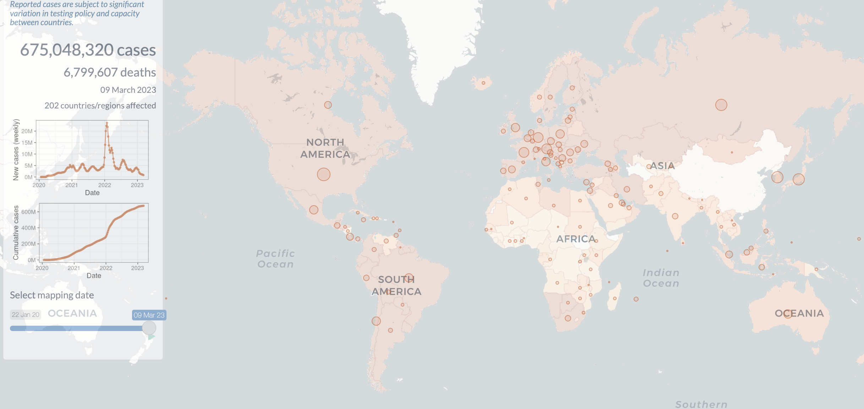
Interactive data-driven websites

Slide 24
Getting ready for next week
Install R
Install R Studio
Install packages as a group

